Slide 1
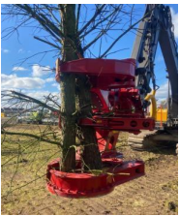
Health & Safety
Executive
Treework Safety
NAAC Taking responsibility for treework
Kathy Gostick (Edinburgh)
HSE Engagement & Policy Division
National lead for Forestry & Arboriculture Sector Policy
Notes:
Increasing nos Treework 6 times fatal accident rate compared to construction Over 80% of these are tree on cs op Hierarchy of control for mechanisation

Slide 2
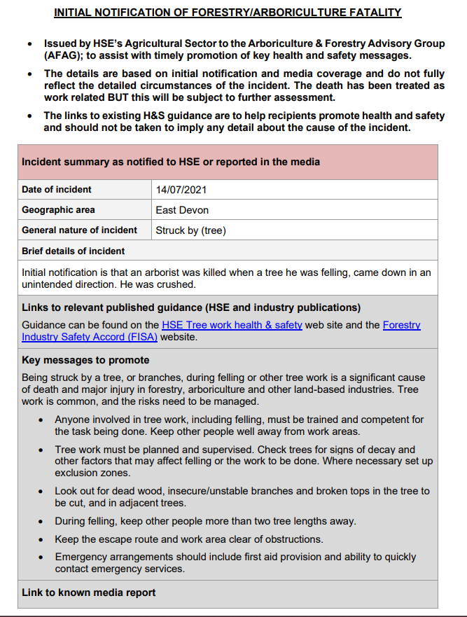
Treework accident stats
Treework is dangerous - tragically highlighted by the 11 related deaths which occurred in 2021
Initial Notifications of Forestry / Arboriculture fatalities
These alerts are issued to enable those involved in managing treework safety to be able to see trends and focus work to aid prevent them occurring again
Initial (pre-investigtion) details currently not capturing tree species
Notes:
Sadly includes deaths on farms – often due to occasional chainsaw users not recognising high risk situations
Focus on planning and mechanisation

Slide 3
Treework risks & Ash Dieback (ADB )
Majority of fatal and serious injury accidents involve one cause; chainsaw operator /groundsmen struck by falling timber
Work at height is another main cause
ADB is a key issue increasing this risk as the trees being worked on become more unpredictable to work on and in Recognise risk of ADB (competence inc tree inspection AA Basic Intermediate & Advanced Tree Inspection training) Managing-ash-dieback (.gov.uk)
Notes:
Dot Gov webpage collates guidance

Slide 4
Treework: Risk Control Approach
Planned (risk assessed) by competent person considering:
  Hierarchy of control (required by PUWER) eg: mechanise (tree shears / grapple saws) rather than motor manual (chainsaw ops)
  Work at height hierarchy (required by the Work at height Regs) eg: work from the ground, from MEWPS before climbing where practicable
Forwarder
AA’s Treework at height hierarchy flowchart (Arboricultural Association - Work at Height – interpreting the hierarchy (trees.org.uk))
FISA’s Competency Webinar
What are the Competency Frameworks? (ukfisa.com)
Chainsaw operator
Hauliers
Harvester
Notes:
Industry guidance on how to plan treework ops. I will go on to provide detail of common mechanisation option – tree shear and grapple saw attachments. Removes chainsaw operators from beneath trees

Slide 5
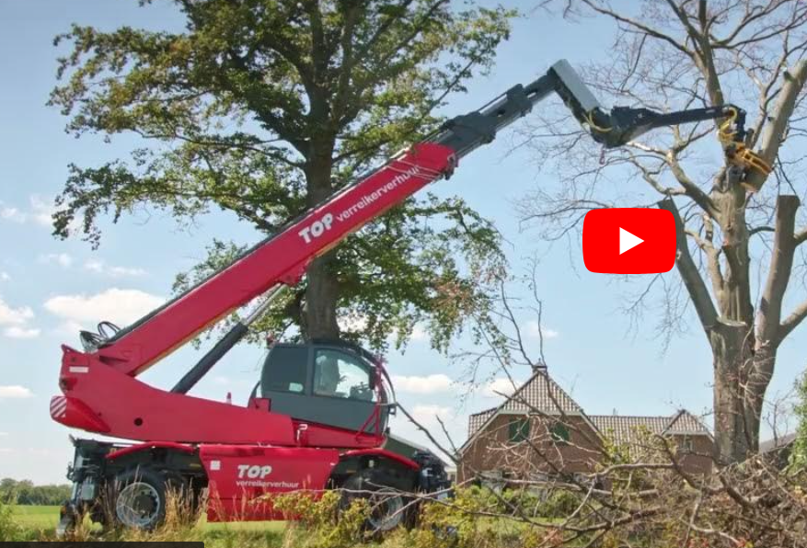
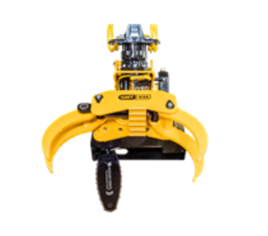
Mechanisation:
Tree shears and grapple saws
https://youtu.be/qK4TkBM_BZ4
Forwarder
Chainsaw operator
Hauliers
Harvester

Slide 6
Mechanisation:
Tree shears and grapple saws
Forwarder
Chainsaw operator
Grapple saws
Tree shears
Hauliers
Harvester
Notes:
Difference between grapple saws and tree shears

Slide 7
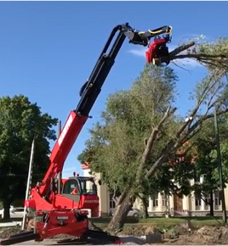
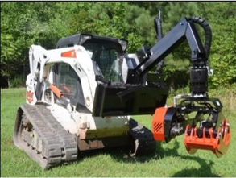
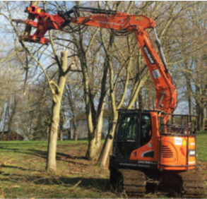
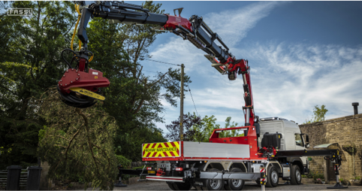
Mechanisation:
Tree shears and grapple saws
Harvester
Notes:
They can be fitted to almost any type of base machine

Slide 8
Mechanisation:
Tree shears and grapple saws
New technology ( ~2 years)​
Combination of a clamp and either shears or saw which can grab and cut trees from small branches to whole trees.​
Can potentially be found fitted to almost any piece of mobile plant but beware, not all plant is suitable​
Range in cost from a few hundred pounds for a cheap attachment to many thousands for a custom built machine.​
Used anywhere from small domestic gardens, small woods and edge trees in forestry. ​
Roadside clearance​
HS2​
Many bought with grants following COVID lockdowns​
May now be in excess of 1000 machines in UK​
Significant risks of serious or fatal injury if not used correctly
Harvester
Notes:
They can be fitted to almost any type of base machine

Slide 9
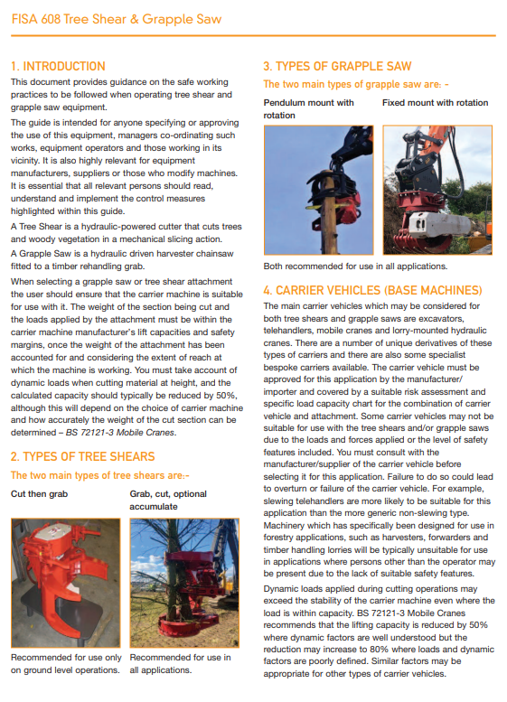
Mechanisation:
Tree shears and grapple saws
NEW FISA 608 Guide: FISA 608 (ukfisa.com) (includes training outline) following Safety Alert Tree Shears/Grapple Saws
Interchangeable equipment on multiple base machines eg: excavators, telehandlers, cranes, hiabs
Key risk areas:
  Base machine suitability inc stability / FOPS /OPs & ROPs BS EN ISO 11850-2011 / Lift capacity
  Operator competence eg: Lift planning (APs (Appointed Person)) including knowledge of tree section weights
  Risk zones particularly as in more urban areas than forest harvesters inc. consideration of chainshot (could require100 m+ ). NB: road closures: Safety at Street Works and Road Works Code of Practice
Notes:
New FISA Guide 608 Guide and training outline
Highlight Suitability (FOPS OPs ROPs & LOLER (No trial lift….lift plan needed) Chainshot (manuf. Statement of risk)
Selection of competent contractor inc knowledge of relevant industry Treework safety standards

Slide 10
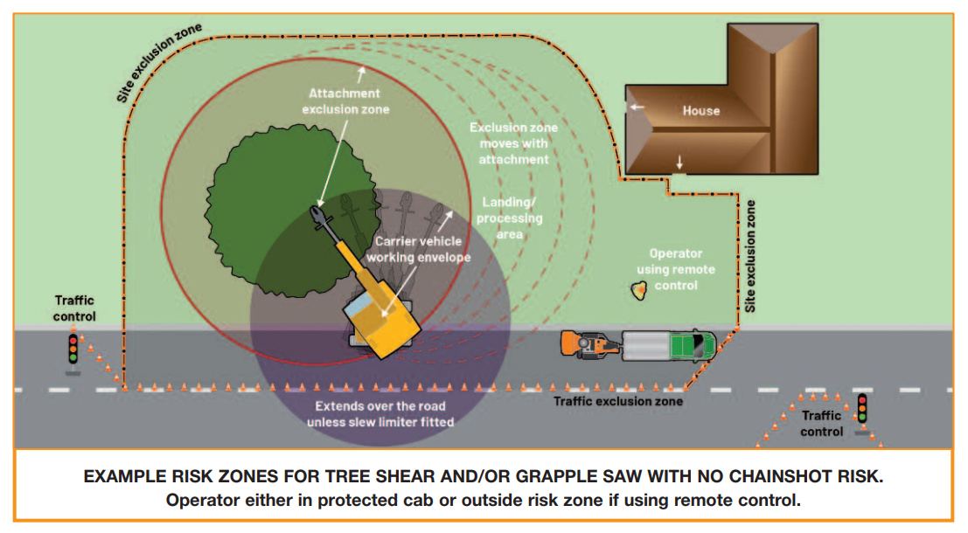
Risk Zones for Tree shears / grapple saws
Notes:
Often used in more urban areas with more people at risk
Highlight different (manufacturer) risk zones (attachment and carrier and product length (2 x)) and consideration of traffic control

Slide 11
Grapple saws /tree shears – how can it go wrong?
OHPL down (planning and lift planning (overweight / too long a section)
Failure of hitch to base machine (Coop / Coordination between base machine and interchangeable equipment manufacturers)
Worn quickhitch failed (maintenance issue)
Overloaded telehandler / partial overturn (too big a section)

Slide 13
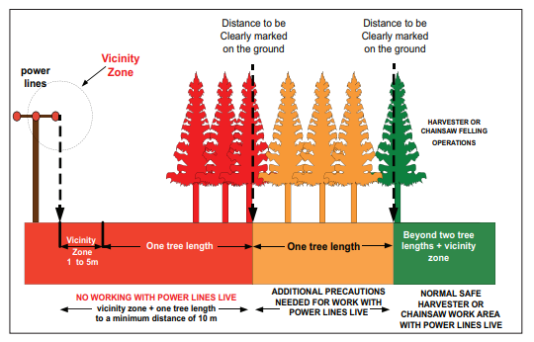
FISA 804 Electricity at work: Forestry
If tree-felling work is required within the Red Zone with the line energised, then this will only be carried out by staff engaged directly by the Network Operator, with the Network Operator acting as FWM.

